Slide 1
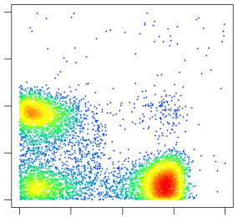
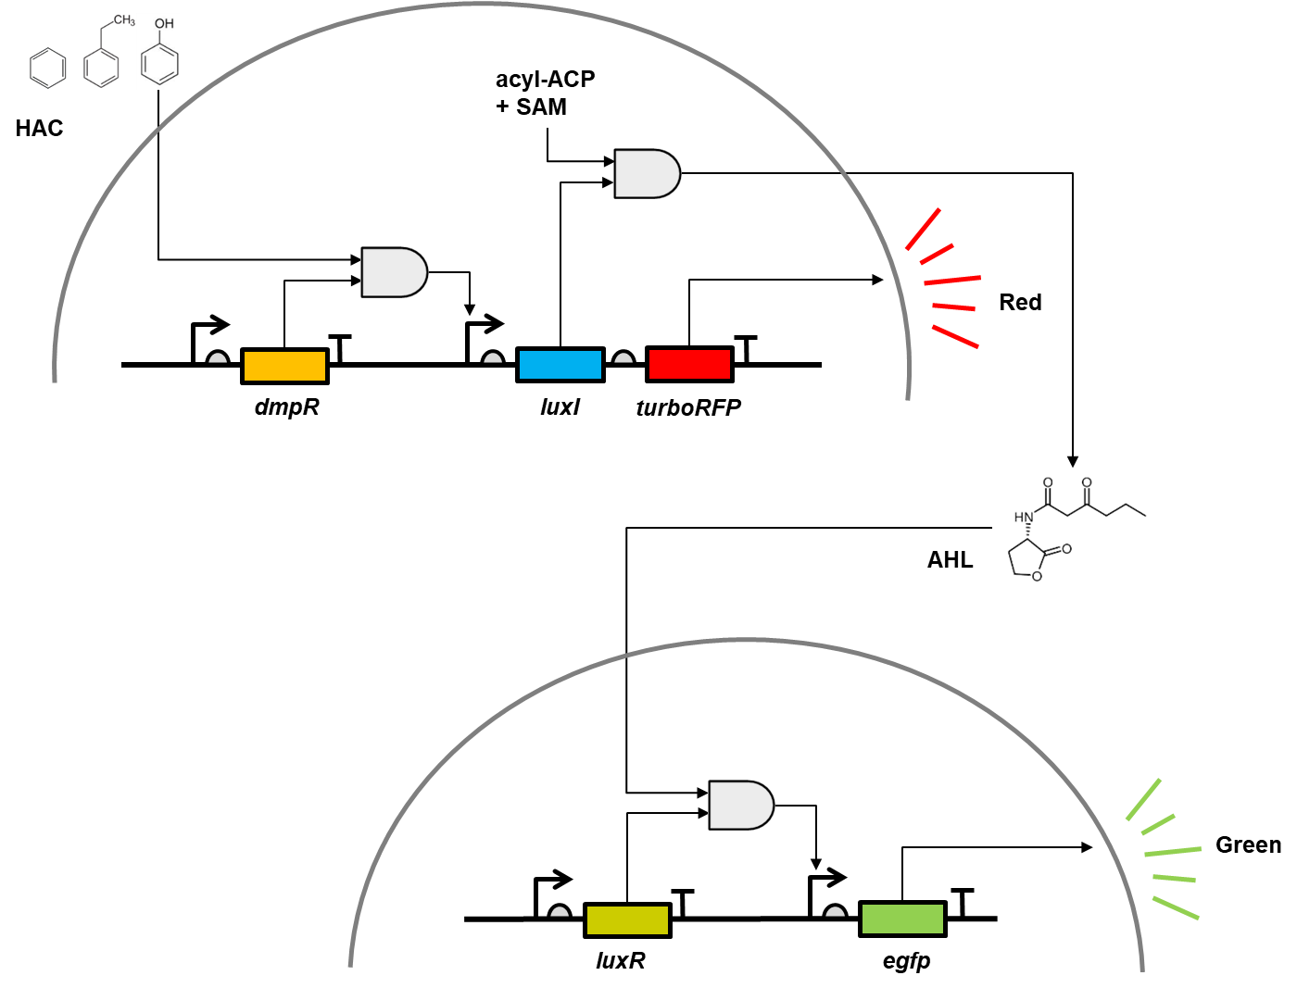
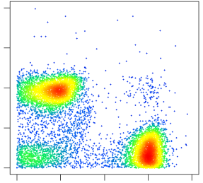
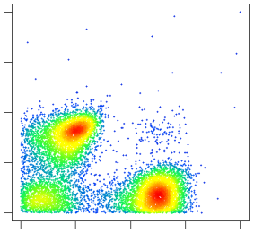
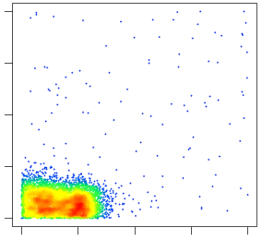
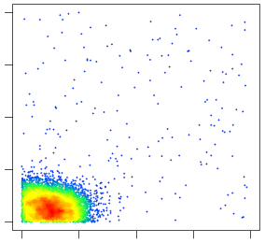
(B)
Phenol 1000μM
(A)
RFP
0 10 10² 10³ 10⁴
Phenol 100μM
RFP
0 10 10² 10³ 10⁴
Phenol 10μM
RFP
0 10 10² 10³ 10⁴
Phenol 1μM
RFP
0 10 10² 10³ 10⁴
Figure 1. Mixed microbial biosensor construction. (A) schematic diagram of the mixed microbial biosensor. Hazardous aromatic compounds (HAC) activate DmpR which expresses LuxI and turboRFP in a detector cell. LuxI converts S-adenosylmethionine (SAM) and an acylated acyl carrier protein (ACP) to acyl homoserine lactone (AHL) which triggers egfp expression in reporter cells. (B) Single cell level florescence distribution of the mixed microbial biosensor. Phenol molecules triggers detector cells to express red fluorescence protein (RFP) while reporter cells to produce green fluorescence protein (GFP).
Phenol 0μM
RFP
0 10 10² 10³ 10⁴
0 10 10² 10³ 10⁴
GFP

Slide 2
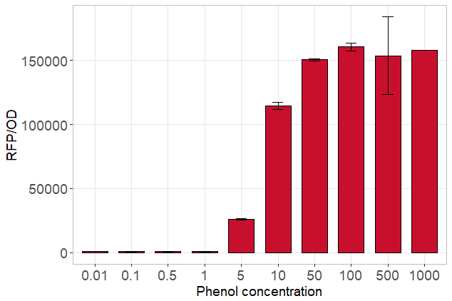
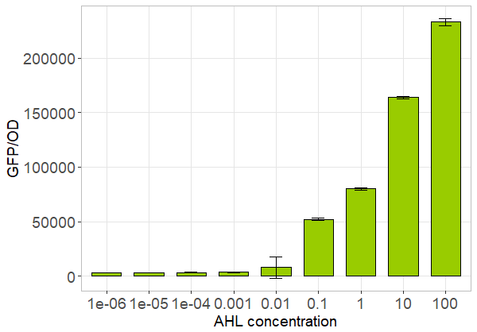
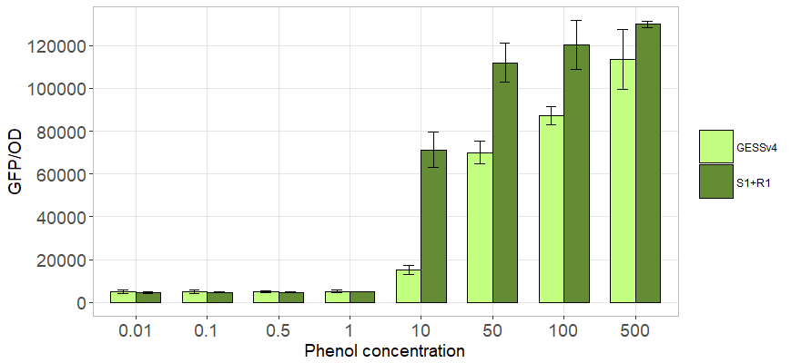
Mixed microbial biosensor characterization
(A) Detector cells
(B) Reporter cells
(μM)
(μM)
(C) Detector + Reporter (1:1) vs. Whole cell (GESSv4-eGFP)
(μM)

Slide 4
Remote detection of hazardous chemicals with cell-cell communication genetic circuits
유해물 감지 필요성으로 인한 다양한 바이오센서 개발되고 있음
그러나 유해물 특성상 원거리 감지 필요하며 따라서 바이오센서의 경우 높은 가시화 효율 및 그에 상응하는 측정 디바이스 필요 (ex 폭발물)
세포간 통신 유전자 회로 구축을 통한 감지 신호 증폭 및 범위 확장
3D 프린터 및 아두이노 응용한 저가형 형광 감지 및 분석 디바이스 개발
Alginate Bead 기반의 유해물 (페놀) 감지를 통한 실용화 모델 제시
In this paper,
Notes:
Vibrio fischeri

Slide 5
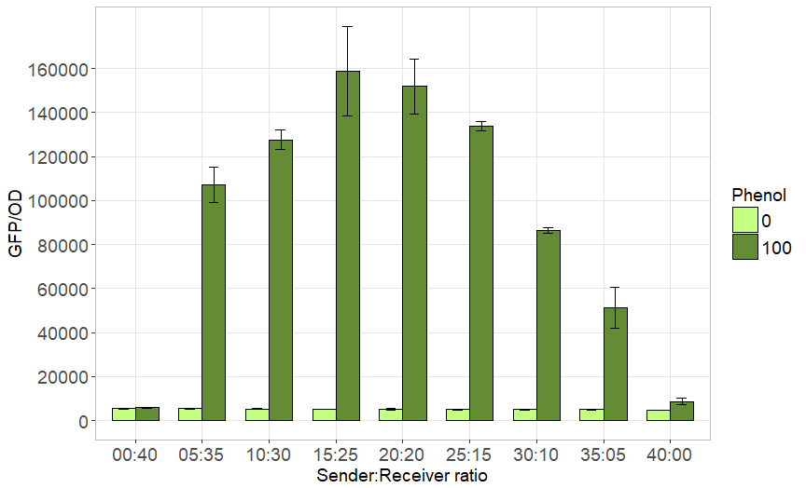
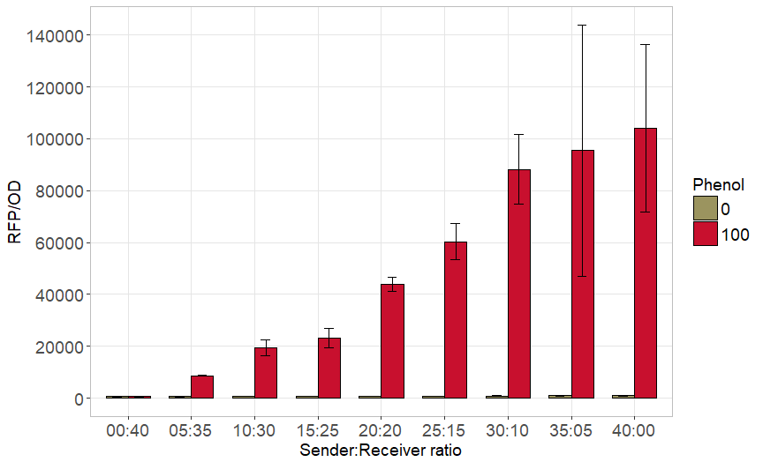
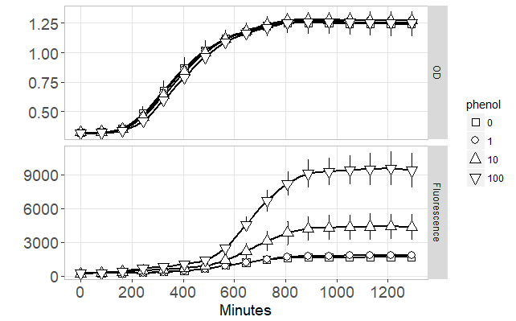
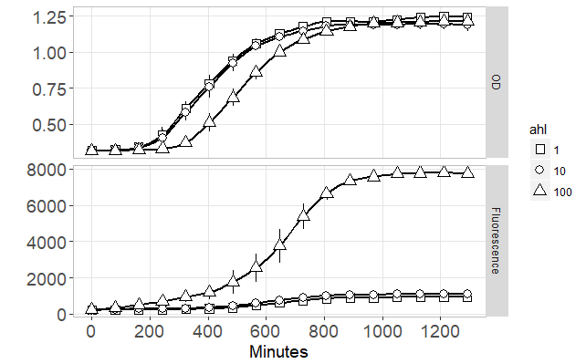
Mixing ratio of sender and receiver
(A) Mixing ratio
(B) Mixing ratio
Fluorescence decreasing with heterologous fluorescence reporters
Growth problem (growth rate variation with crosstalk, slow response)
(C) Mixing ratio
(D) Mixing ratio

Slide 6
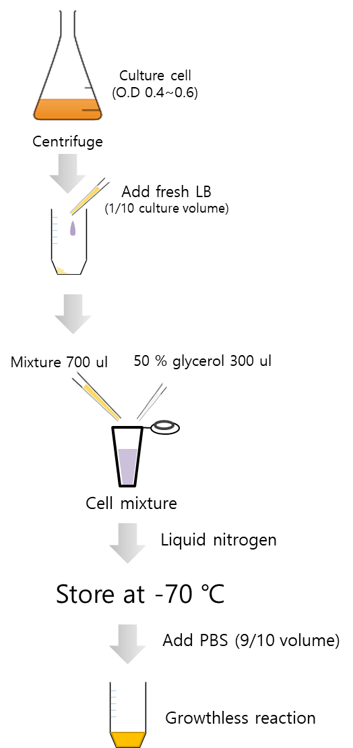
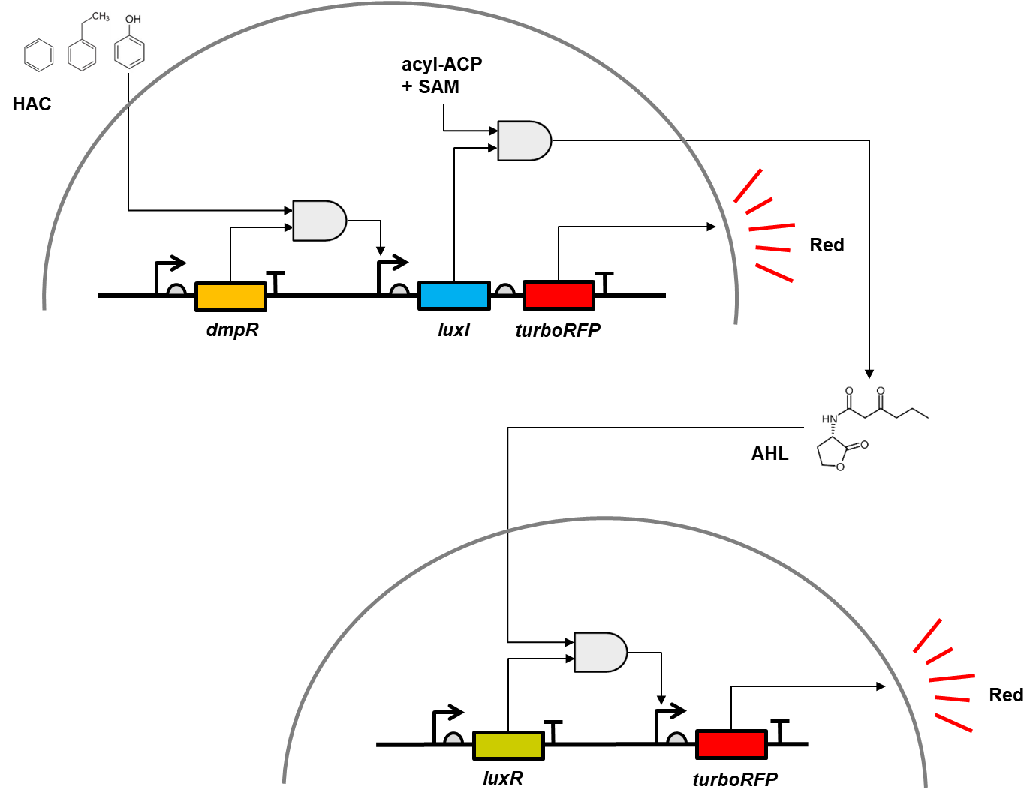
Freeze based mixed microbial biosensor
(A)
(B)

Slide 7
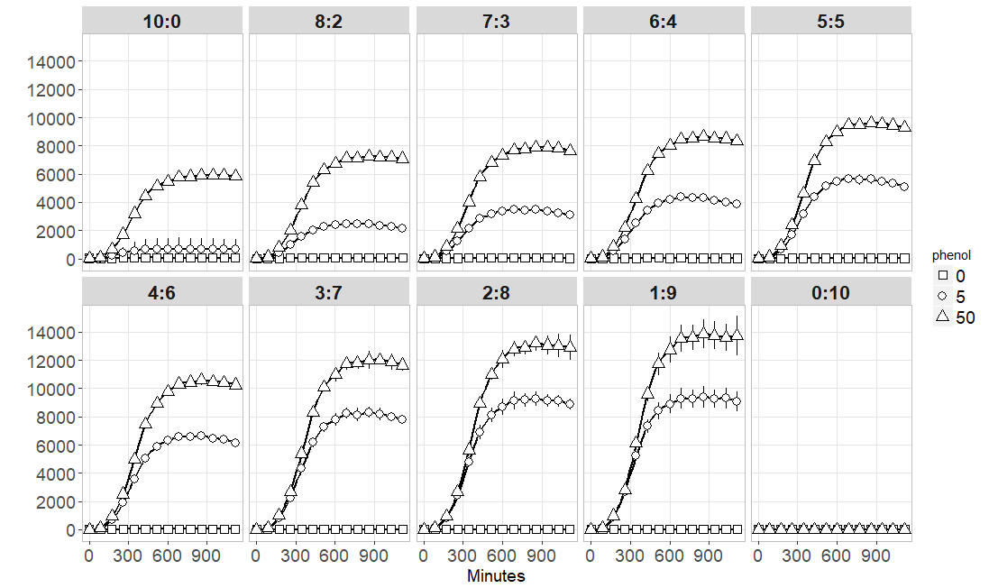
Sender receiver ratio of FMMS
RFP/OD

Slide 9
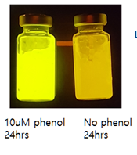
Figure 3

